Slide 1
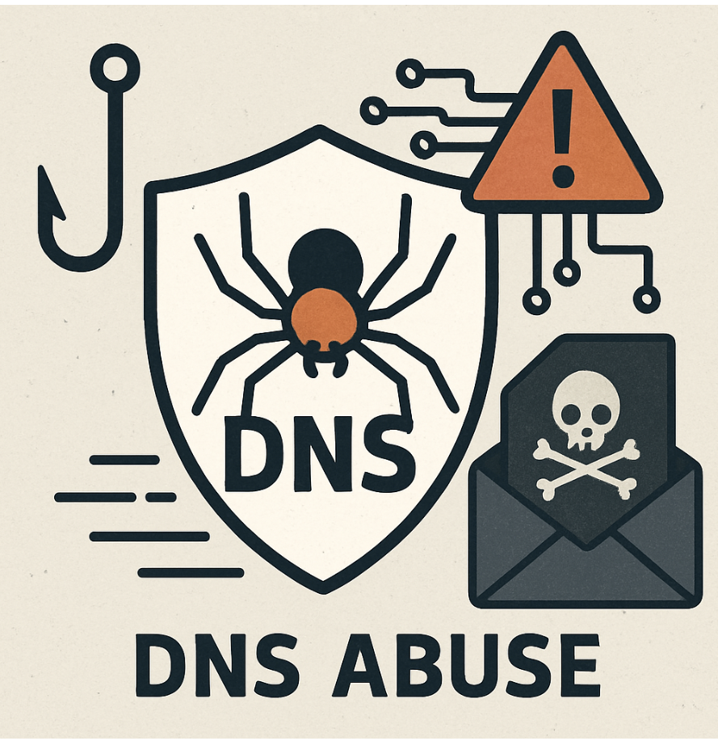


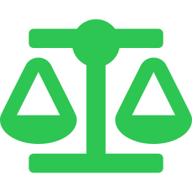
THE CHALLENGES POSED BY THE DOMAIN NAME SYSTEM FOR LAW ENFORCEMENT
Key Threats Produced by the Domain Name System (DNS) and practices Law Enforcement may consider

Slide 2



HISTORICAL DNS ISSUES
Designed in 1983
No Built-In Security
Internet's Foundation
DNS was built before security was a concern. No encryption or authentication was included by default.
DNS queries and responses travel in plain text. Attackers can intercept, read, and modify them freely.
DNS is required for virtually every internet connection, making it a high-value, high-impact attack surface.

Slide 3
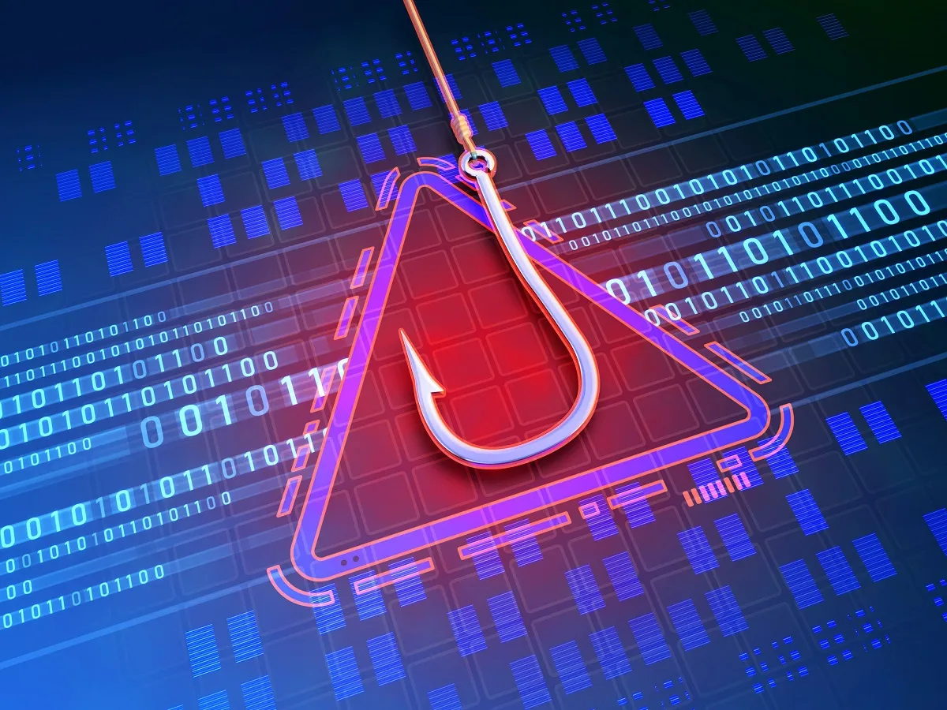
PHISHING – Most Frequent and Widely Used Attack Method Driving Cybercrime
Phishing is when criminals used fraudulent websites to imitate trusted entities like government agencies, banks or popular services and companies to send fraudulent messages—usually by email or text—tricking victims into revealing sensitive data, sending money, or clicking malicious links that download malware or ransomware.
Phishing attack frequency has increased by 423% since 2020, with over 7.5 million phishing attacks reported between 2020 and 2025. (Phishing Landscape 2025 Report by Interisle Consulting Group, September 2025 available at https://domainnamewire.com/wp-content/Interisle_Phishing-Landscape-2025.pdf) Just in the U.S., residents lost over $148 billion due to cybercrime in 2025, a 26% increase from 2024.(https://consumerfed.org/news/press-releases/americans-lost-an-estimated-148-billion-to-online-scams-crimes-in-2025-up-nearly-26-from-2024-1009-per-household-average/)
Cyber criminals engaged in phishing rely on domain names to launch their attacks and lure victims to websites where they give data, send money, or download malware.
.

Slide 4


PHISHING AND ABUSE OF DNS
How Cybercriminals Weaponize Domain Names
The Scale of the Problem
Typosquatting
90%+
Register misspelled variants of domain names (e.g. whatsalpp.com) to trap users who mistype.
Cybersquatting
of typosquatting visitors are directed to scams, malware, or illicit content
Register domain names of trademarked brand names in bad faith to extort or deceive.
Combosquatting
AI-Powered
Combine brand names + words like 'security' or 'payment’ in domain names to create convincing fakes.
Domain Snapping
Phishing campaigns are now being automated by use of Artificial Intelligence (AI)— targeting a wide range of victims using more domain names and more sophisticated attacks. AI is expected to continue to accelerate the increase in cybercrime.
Buy up expired domain names with existing reputation to deceive victims.

Slide 5




DNS AS CRIMINAL INFRASTRUCTURE
1
2
3
4
Register
Host
Attack
Disappear
Criminals register cheap domain names with fake registrant (WHOIS) data — anonymously and at scale. They also use privacy or proxy services. And they use bulk registration services to register hundreds or thousands of domain names.
Criminals create malicious websites at the domain names to steal victim data, money and/or deliver malware.
Victims lured via emails, text messages or ads. The DNS then routes them to criminal infrastructure via domain names acquired by the criminals.
Domain names used for phishing abandoned or transferred. Low cost and ability to bulk register huge numbers of domain names in a few minutes mean criminals discard and rotate abusive domain names constantly.

Slide 6

DNS AS CRIMINAL INFRASTRUCTURE
“Domain names are an essential resource for committing all types of cybercrime. They provide the locations for phishing, malware, scam and fraud sites, are used to control botnets, and to advertise abusive activities through email, on social media and via text messages.”
Source: “Malicious Registrations in the Domain Name Market” Interisle Consulting Group, June 2026, available at: https://static1.squarespace.com/static/63dbf2b9075aa2535887e365/t/6a20724a659b821142b48388/1780511306582/FullReport_MaliciousRegistrationsintheDomainNameMarket_2026_rev.pdf

Slide 7
MARKET EXTERNALITIES ENCOURAGE DNS PROVIDERS TO DO BUSINESS WITH CYBERCRIMINALS
--Competition: increasing number of generic Top-Level Domains (gTLDs) and more to come in 2027.
--Low Margins and Low Pricing: some domain names sold for less than 1 euro for the first year.
--Cybercriminals Purchase in Bulk: high volume sales bring revenue and market value to domain name registries and registrars.

Slide 8
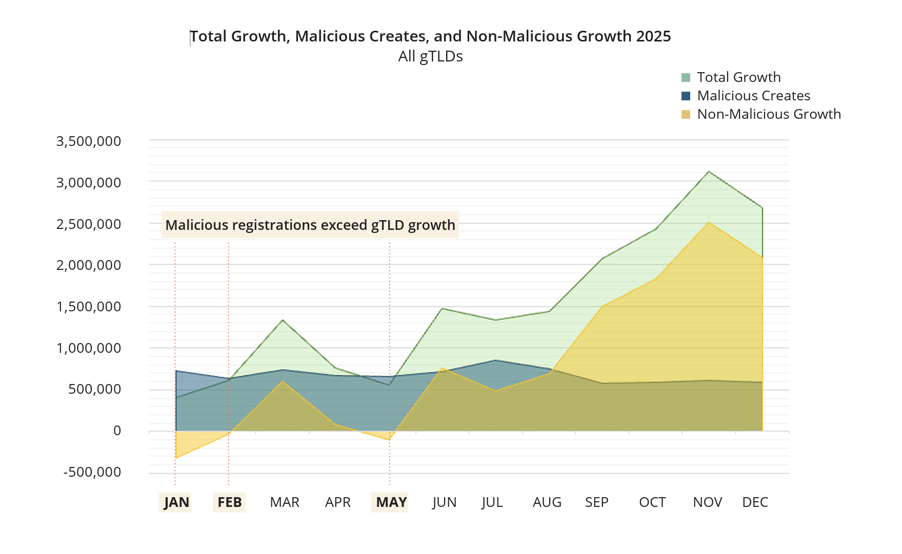
SUBSTANTIAL MALICIOUS DOMAIN NAME REGISTRATIONS IN gTLDS IN 2025
Source: “Malicious Registrations in the Domain Name Market” Interisle Consulting Group, June 2026,

Slide 9



BULK DOMAIN NAME REGISTRATIONS BENEFIT CYBERCRIMINALS
Bulk registrations allow the registration of hundreds and sometimes thousands of unique domain names in a single batch/transaction in minutes.
Cybercriminals use bulk registration to “register millions of domain to perpetrate abuse at scale.”
Of the 8.3 million gTLD domain names registered in 2025 that were blocklisted through 30 April 2025, 88% were bulk registrations.
ICANN’s own research indicates that where bulk registrations are prevalent, they significantly predict higher abuse rates.
Source: “Malicious Registrations in the Domain Name Market” Interisle Consulting Group, June 2026,

Slide 10
MARKET EXTERNALITIES ENCOURAGE DNS PROVIDERS TO DO BUSINESS WITH CYBERCRIMINALS
According to the Interisle June 2026 Report:
“Some (registry and registrar operators) may be deriving commercial benefit from sales to criminals. . . While cybercriminals and certain registrars and registry operators may benefit, the costs of cybercrime facilitated by abusive registrations fall on victims, businesses, and society at large. In economic terms this is a classic negative externality, where the parties who benefit from the transaction do not bear the full costs they create.”

Slide 11
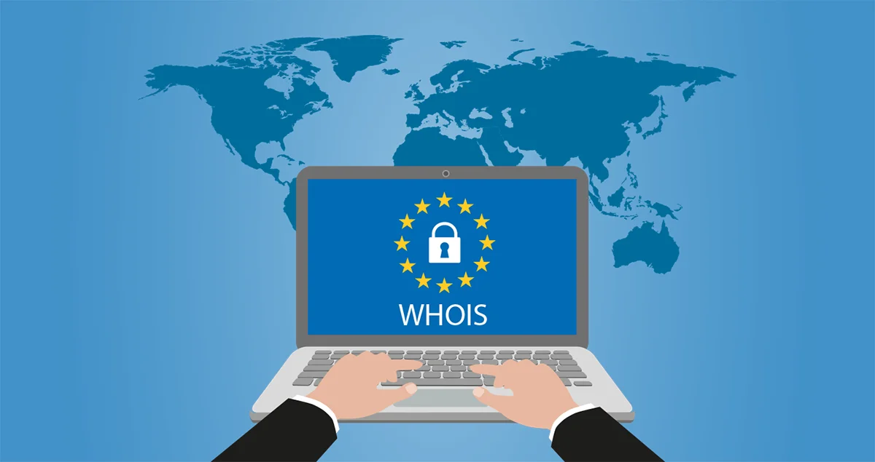

ARTICLE 6 of 2AP Budapest Convention – Request for Domain Name Registration Information
1. Each Party shall adopt such legislative and other measures as may be necessary to empower its competent authorities, for the purposes of specific criminal investigations or proceedings, to issue a request to an entity providing domain name registration services in the territory of another Party for information in the entity’s possession or control, for identifying or contacting the registrant of a domain name.
BUT domain name registration information (WHOIS data) has been mostly unavailable since 2018
.

Slide 12
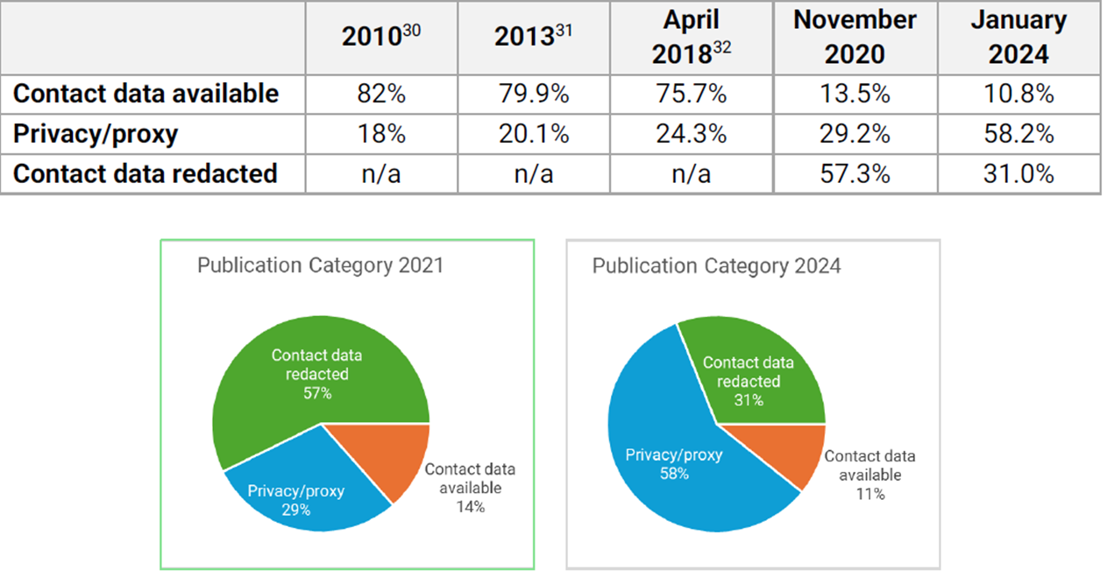
DOMAIN NAME REGISTRANT / WHOIS DATA INCREASINGLY UNAVAILABLE
As of early 2024, only 10.8% of publicly available domain records identified the actual domain name registrant. A dramatic increase has occurred in the use of privacy/proxy services for generic Top Level Domain name registrations.
Source: “Domain Name Contact Data Availability and Registrant Classification Study” Interisle Consulting Group, June 2024 available at www.dnib.com/media/downloads/reports/Interisle_gtld_contact_data_study_final.pdf

Slide 13

CYBERCRIMINALS TAKE ADVANTAGE OF PRIVACY/PROXY SERVICES
The DNS Research Federation reported in 2024 that:
65% of domain names on abuse lists used privacy/proxy services
Study available at: https://dnsrf.org/blog/privacy-proxy-services---a-safe-haven-for-cybercriminals-/index.html

Slide 14
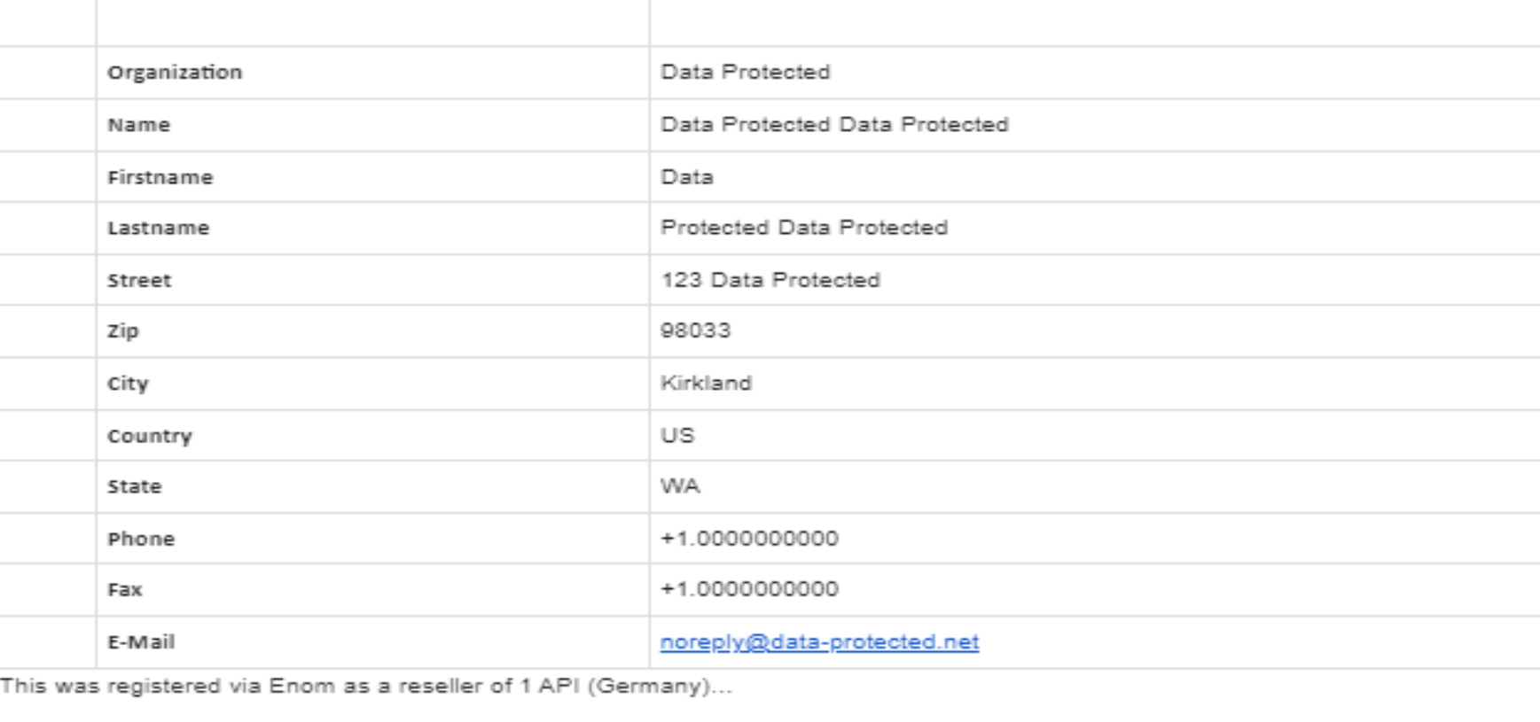
EXAMPLE OF DATA DELIVERED IN RESPONSE TO REQUEST FOR DOMAIN NAME REGISTRANT INFORMATION

Slide 15
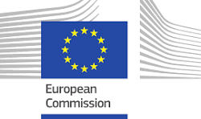
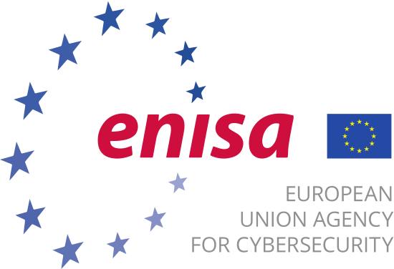
IMPORTANCE OF WHOIS DATA
“Requir[e] the registrars to carry out strict identification of the registrants’
identity . . . in order to enter correct and accurate registration (WHOIS) data.”
“Prevention is better than cure’ applies here too.”
European Commission Study on evaluation of practices for combating speculative and abusive domain name registrations August 2020 available at: https://digital-strategy.ec.europa.eu/en/library/study-evaluation-practices-combating-speculative-and-abusive-eu-domain-name-registrations
“Verification of data used for initial registration is an essential component of the attempt to provide accurate registration information for uses beyond the operation of the DNS. . . While verification and authentication of registrants is a topic of concern to ICANN, governments and policy makers have recently been looking outside the boundaries of ICANN to have an influence on the security of the registration ecosystem.” ENISA study on DNS Identity May 2023 available at: https://www.enisa.europa.eu/sites/default/files/publications/DNS%20Identity.pdf

Slide 16
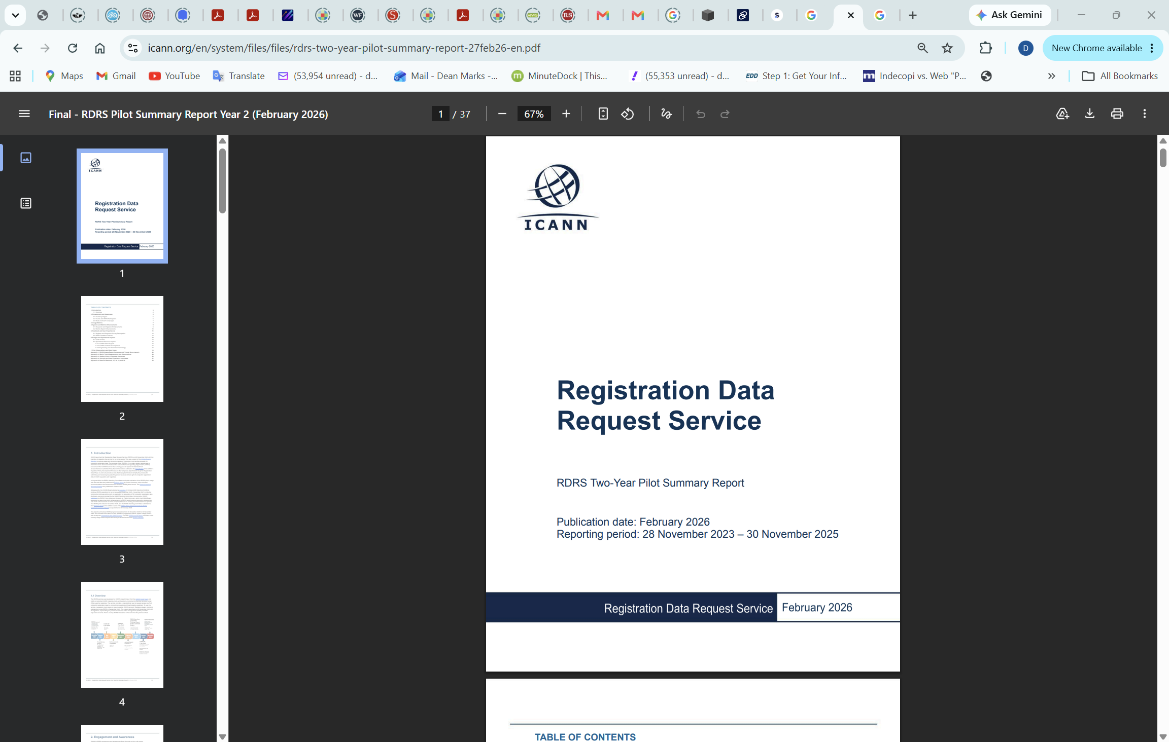
ICANN’S RDRS NOT VERY HELPFUL
Participation is voluntary and currently participating registrars represent only 46% of gTLD domain registrations.
61% of requests made through RDRS were denied.

Slide 17
PRACTICES LAW ENFORCEMENT TO CONSIDER
When making a request for domain registrant data directly to a registrar, consider including the following language:
“If this domain registration was made, entered, or recorded by or with the assistance of a proxy or privacy service that is affiliated with or a subsidiary of your registrar company or organization, then this request should be responded to with the data and contact information of the customer of the proxy or privacy service. Supplying just the name and/or contact information of the proxy or privacy service will not be considered a valid response to this request.”
Also consider requesting all the registrar’s business records related to the domain name, including payment information used by the registrant to acquire the domain name.
.

Slide 18
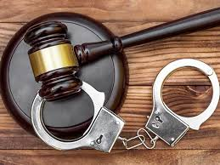
PRACTICES LAW ENFORCEMENT TO CONSIDER
Where a domain name is associated with clearly criminal activity and the registrant of record is a proxy service, consider working with prosecutors to bring a criminal complaint against the proxy service for aiding and abetting the criminal activity or acting as a co-conspirator in the criminal activity, due to the proxy service acting as the registrant of the domain name..
.

Slide 19

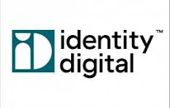
PRACTICES LAW ENFORCEMENT TO CONSIDER
Reach out to SIRIUS platform for potential trusted notifier arrangements with registry operators to suspend or lock domain names associated with serious criminal behavior.
.
Identity Digital has a trusted notifier arrangement and
is the operator for over 460 Top Level Domains. Europol
and SIRIUS are working with other registry operators to
establish more trusted notifier arrangements.

Slide 20
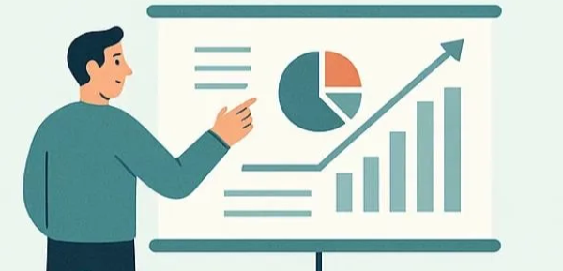
PROACTIVE MEASURES DNS SERVICE PROVIDERS CAN TAKE TO REDUCE CYBERCRIME
Ensure accuracy of and verify registrant data (WHOIS data).
  Name, email address, physical address, phone number
Limit or prohibit use of bulk registrations of domain names.
Limit use of privacy/proxy services.
Investigate any domain names similar to list of regularly
abused famous brands / trademarks / government agencies.
Block/delete all registrations by abusive registrants.
Implement algorithms to identify and prevent abusive domain name registrations.
.

Slide 21
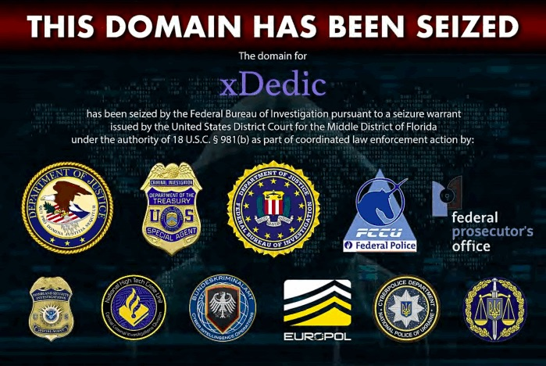
REACTIVE MEASURES DNS SERVICE PROVIDERS CAN TAKE TO REDUCE CYBERCRIME
Respond quickly to WHOIS/registrant data access requests and supply information of beneficial user/owner of the domain name.
Maintain confidentiality of LEA requests for WHOIS/registrant data.
Conduct “reverse WHOIS lookups” when requested by LEAs or other legitimate access seekers.
At request of LEAs, quickly freeze and suspend domain names associated with websites alleged to be engaged in illegal behavior.
Establish voluntary Trusted Flagger/Notifier arrangements with entities and researchers having expertise in areas of cybercrime and cybersecurity and freeze and suspend domain names when notified by such Trusted Flaggers.
Conduct “reverse WHOIS lookups” upon freezing/suspending a domain name under provider’s authority and freeze/suspend all other domain names registered with same WHOIS data.
.

Slide 22
ICANN CANNOT BE RELIED ON TO SOLVE THESE ISSUES
QUOTES BELOW FROM 2022 EUROPEAN COMMISSION REPORT ON DNS ABUSE:
.
Governments do not find “ICANN processes or procedures sufficient to address public safety interests.” (Page 127)
“With ICANN and its contracted parties demonstrating an unwillingness to take meaningful steps to facilitate reasonable publication and disclosure of domain registration data . . . enforcement has become more challenging since 2018. Furthermore, ICANN itself no longer has the ability under current rules to receive and verify that appropriate data accuracy verification is being performed by registrars.” (Page 105)

Slide 23
ICANN CANNOT BE RELIED ON TO SOLVE THESE ISSUES
QUOTES BELOW FROM 2022 EUROPEAN COMMISSION REPORT ON DNS ABUSE:
.
“The contractual obligations in place for gTLD registries and registrars (and resellers, if any) have been found unachieved, ineffective, and/or unenforced by periodic reviews mandated by ICANN by laws.” (Page 136)
“Back in 2010, the Registration Abuse Policies Working Group recommended a community process, supported by ICANN resources, to create non-binding good practices to help registrars and registries address the illicit use of domain names. However, ten years later, ICANN has still not made substantive progress on these issues.” (Page 129)
European Commission Study on Domain Name System (DNS) Abuse, January 2020 available at: https://op.europa.eu/en/publication-detail/-/publication/7d16c267-7f1f-11ec-8c40-01aa75ed71a1/language-en

Slide 24
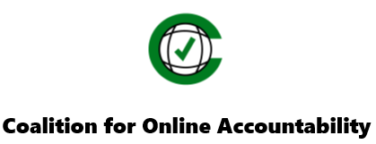
THANK YOU!
All views expressed in this presentation are my own and not of any current or former clients.
m
Please feel free to contact me: Dean S. Marks
E-mail: ed4coa@gmail.com
Cell: +1-818-469-7185

